Slide 1
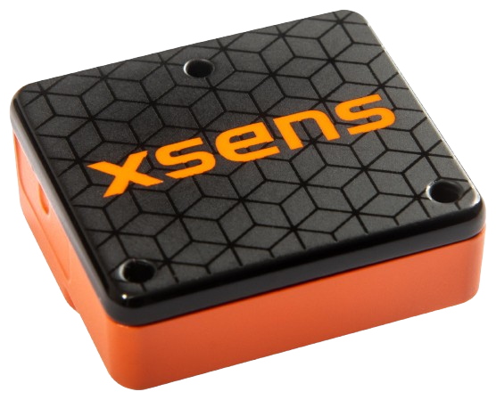
MTI-610 IMU
Description
The MTI 610 is a high-performance Inertial Measurement Unit (IMU) designed for precise 3D motion tracking in demanding environments.
It combines accelerometers, gyroscopes, and magnetometers for accurate measurement of acceleration, orientation, and angular velocity.
The sensor excels in applications requiring real-time motion tracking.
Applications
Robotics and Drones
Autonomous Vehicles
Stabilization Systems
Industrial Automation
Specifications
Operating Voltage - 4.5V to 24V
Operating Temperature : -40ºC to 85ºC
Official Website : https://www.movella.com/products/sensor-modules/xsens-mti-610-imu

